Slide 1

City of Revere
Yuanming (John) Chai , Mackenzie Knox
Quinn Relyea , Giancarlo Sirio, Xavier Ruiz
Notes:
1min Background / Motivation / Goals
3min Results / analysis
30s Challenges along the way
30s Limitations / Next Steps

Slide 2
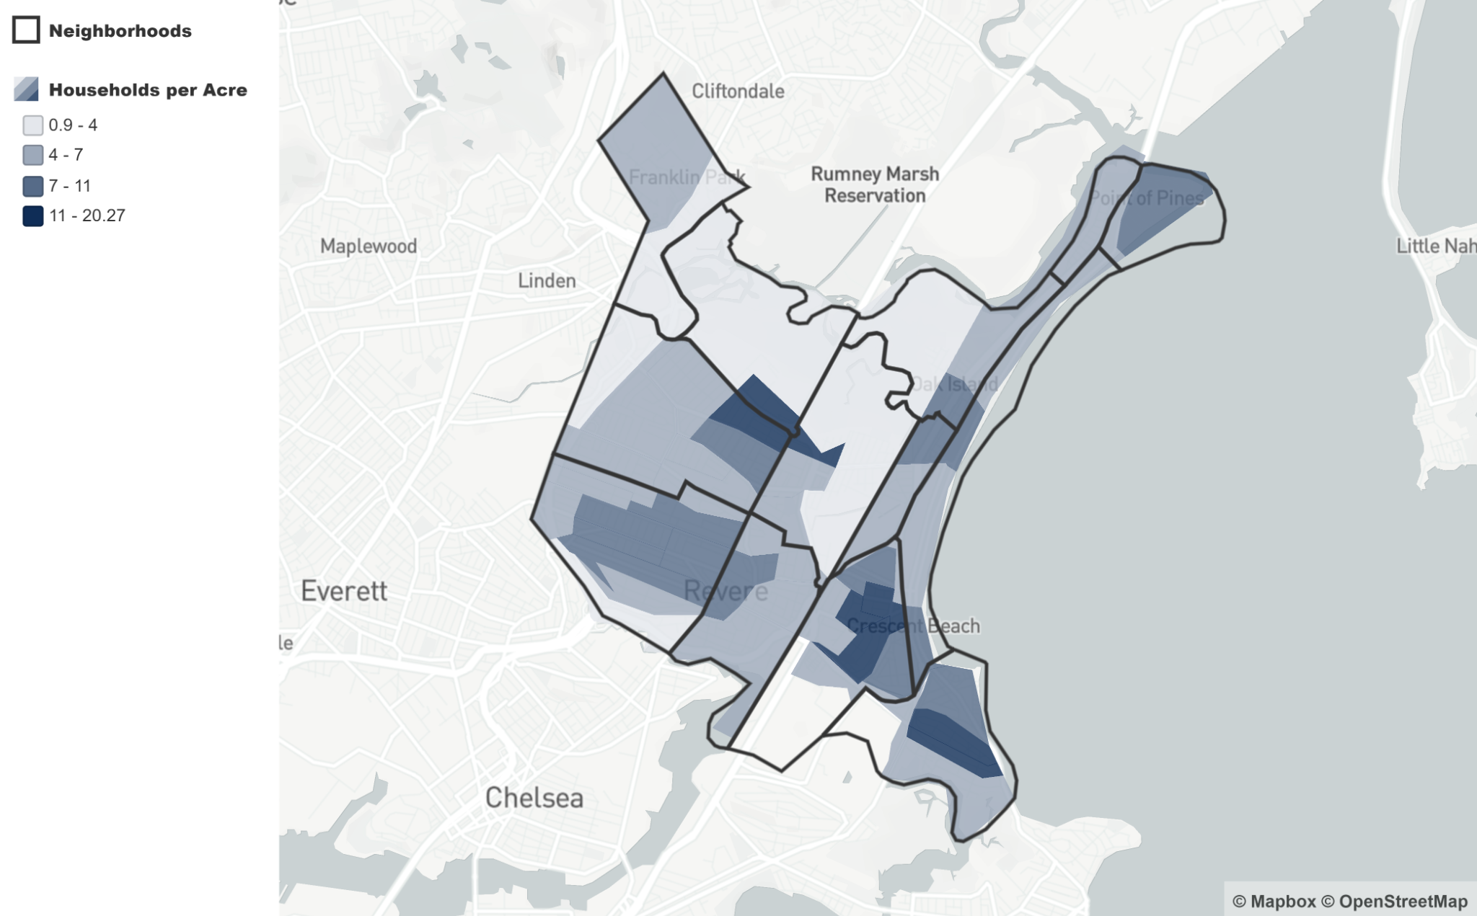
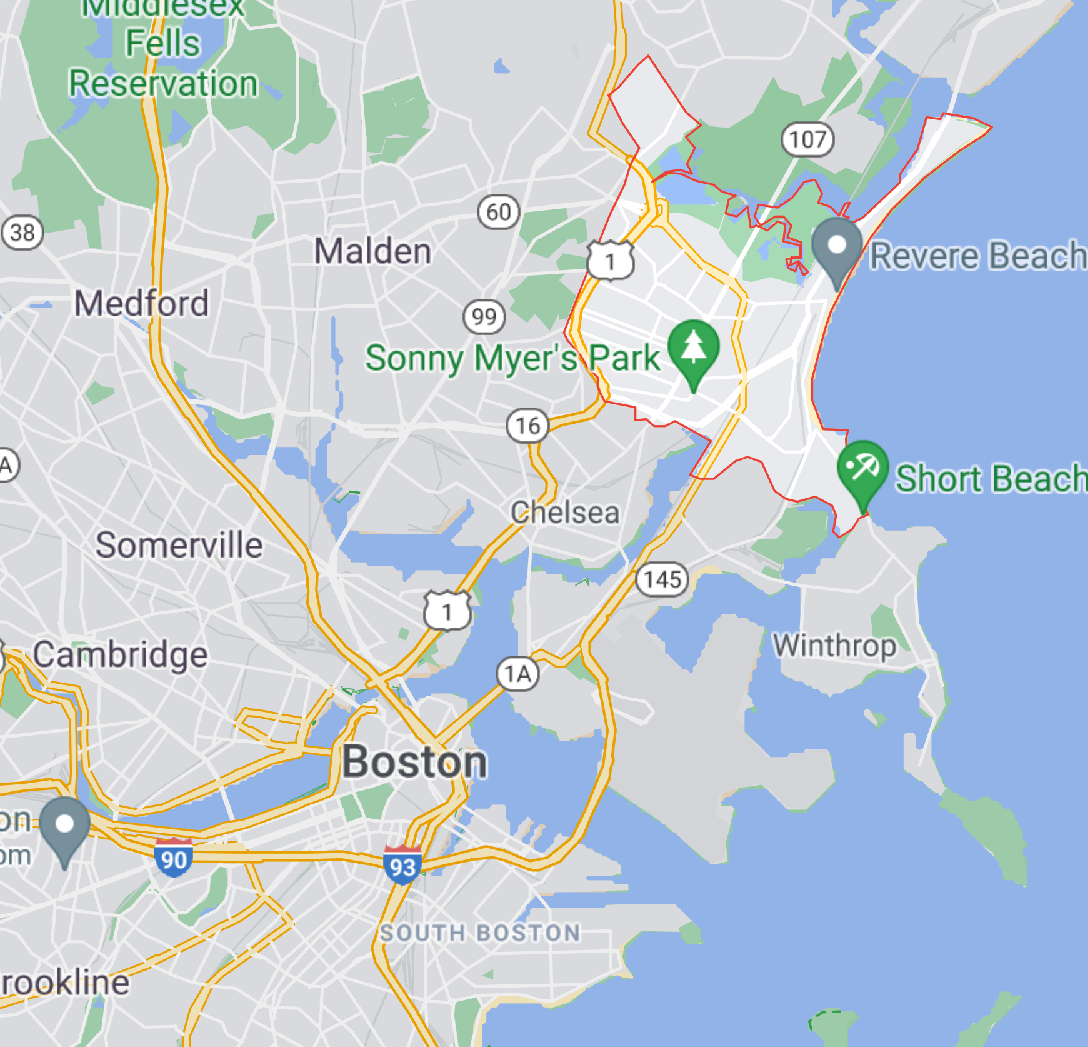
Background, Motivation, and Goals
Revere is a famously working class city
Fast growing immigrant and POC populations
“Smart City”, improve equity among residents
Look at various datasets and determine whether there are discrepancies based on race and ethnicity.
Notes:
Q
Background:
Revere is a famously working class city, with a fast growing immigrant population and a demographic profile that is set to become more and more diverse in the next few decades.
Motivation:
"Smart City Movement", where cities are trying to use data to improve their city services and make sure all citizens are receiving equitable access to city services
Goals:
look at various datasets and determine whether there are discrepancies based on race and ethnicity.

Slide 3
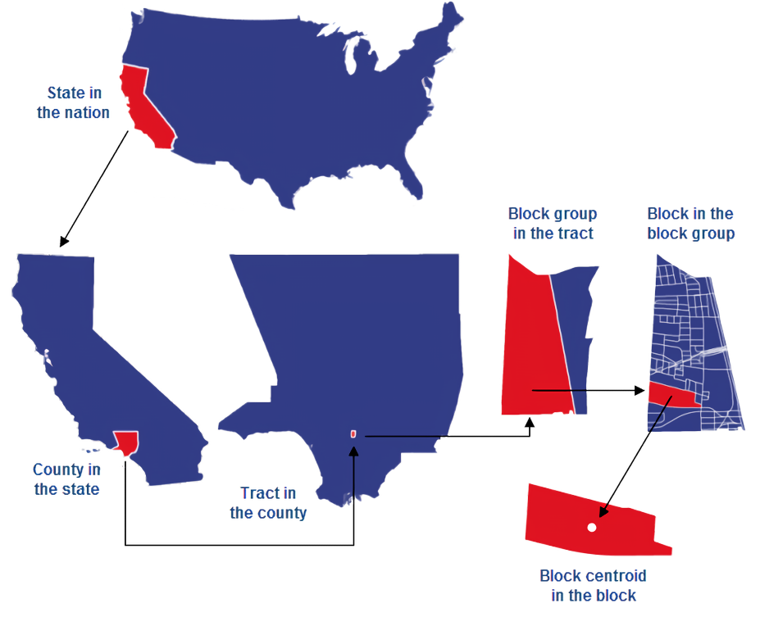
: What we wanted
: What we used
Ideally we would want to take the most segmented data, but the type of Census data currently available only goes down to block groups
Notes:
Q
ALSO INTRODUCE ACS VS CENSUS
Ayyo quinn - I think you want the red one to be green and the picture to the left to be the red one
The one currently in red is showing the block not block group

Slide 4
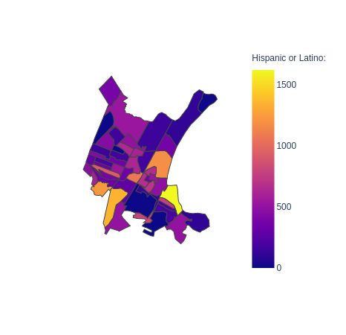
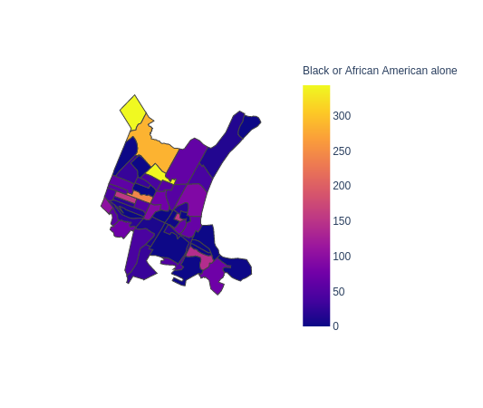
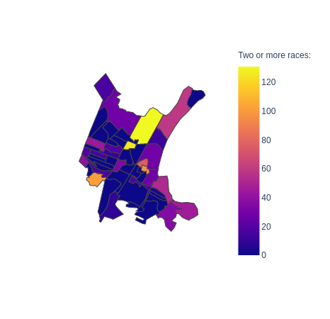
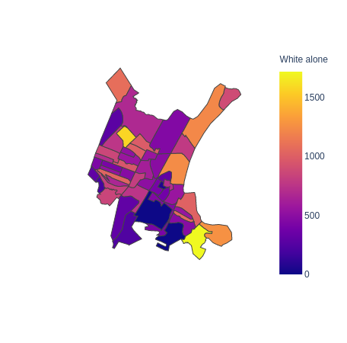
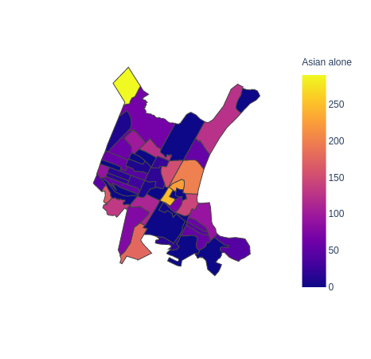
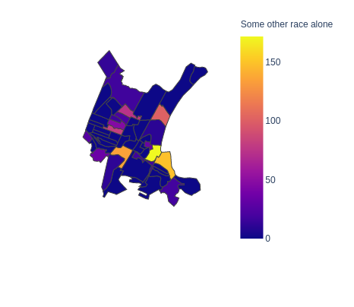
Race and Ethnicity
Hispanic or Latino
Black or African American
Two or More Races
Some other Race
White
Asian
Notes:
Xavier
This race data was enlightening and incredibly helpful for us to narrow our search for disparities.
We used choropleth maps which show a concentration in a given census block group.
The bar on the right shows the concentration scale and each graph here is for a different ethnicity or race.
Please note that each of the bars are on a different scale, Hispanic/Latino has a max of 1500 while Asian has about 300 as a max.
By knowing the hotspots of different races, we were able to keep track of which blocks to pay attention to in other parts of our analysis.

Slide 5
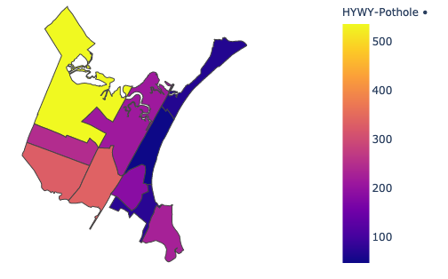
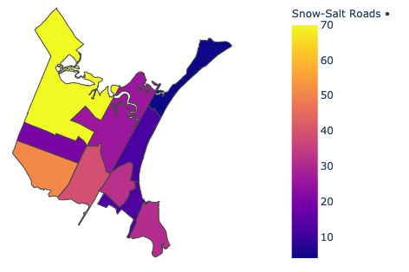
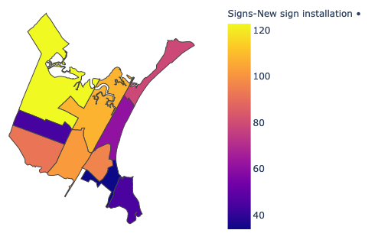
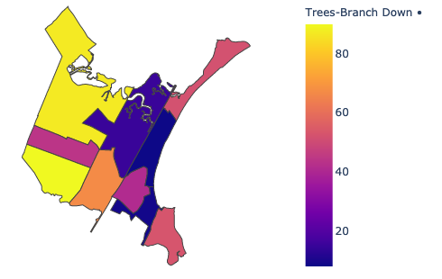
Department of Public Works
Pothole
Salt Roads
New sign Installation
Tree Branch Down
Notes:
Xavier
This is what 311 calls are actually serviced. It is similar in format to the race data, except we split it by census tract.
The most concentrated tract through all these requests was the top left one, tract 1708.
Idk what else to sayyyyyyyyy

Slide 6
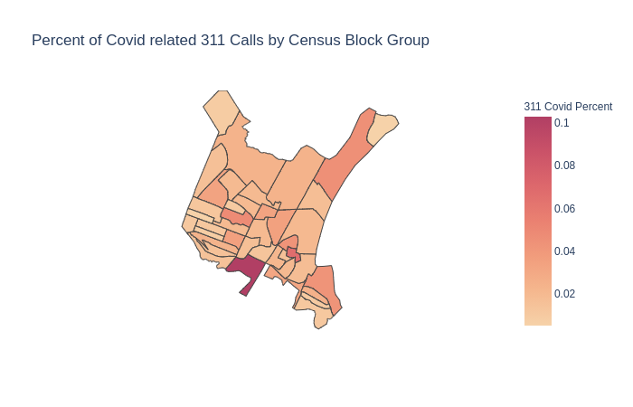
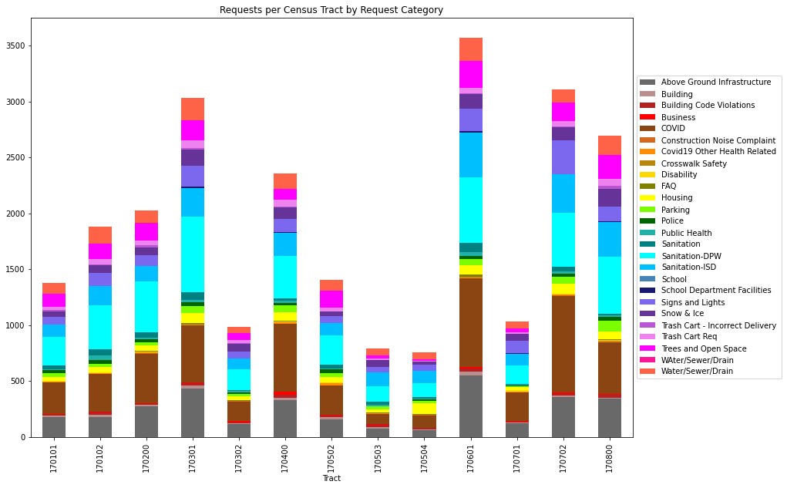
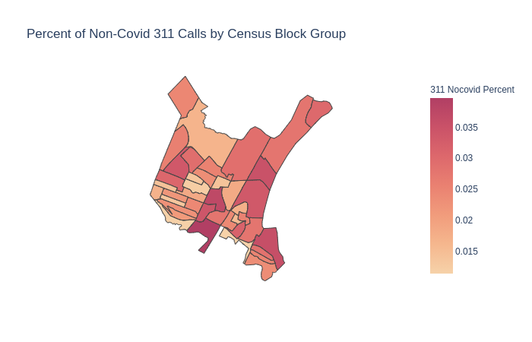
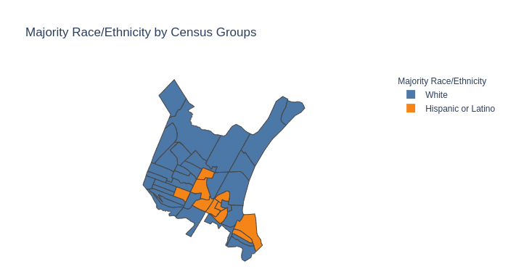
311 Complaints
Non-Covid Requests by block group
COVID Food Assistance by block group
Notes:
John
After examining 311 complaints data by blocks, we discovered that there are some disparity among the density of complaints in different tracts. Then we look into the income and demographic data and after focusing on the top 3 complaint type, we can
Suggest to focus on improving the city services in tract 1707.02 relating to covid-support, pothole and overpopulation. An insight to offer from examining the demographic data is that among the top most dense complaint tracts, majority hispanic tracts has more dense complaints compared to those that are mainly white.

Slide 7
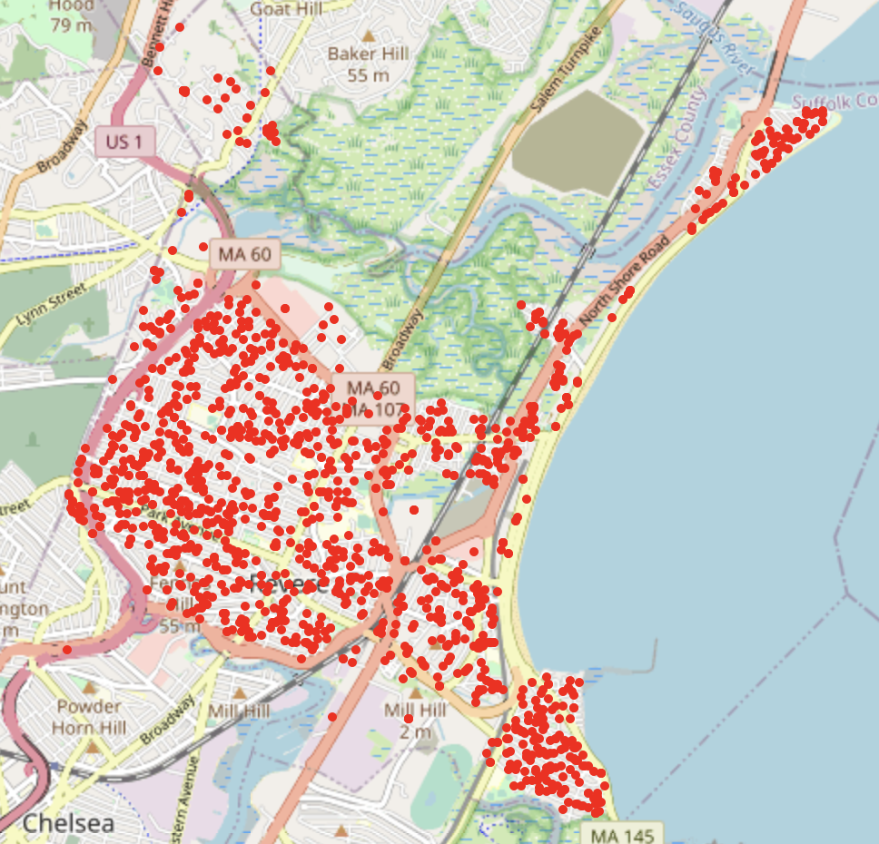
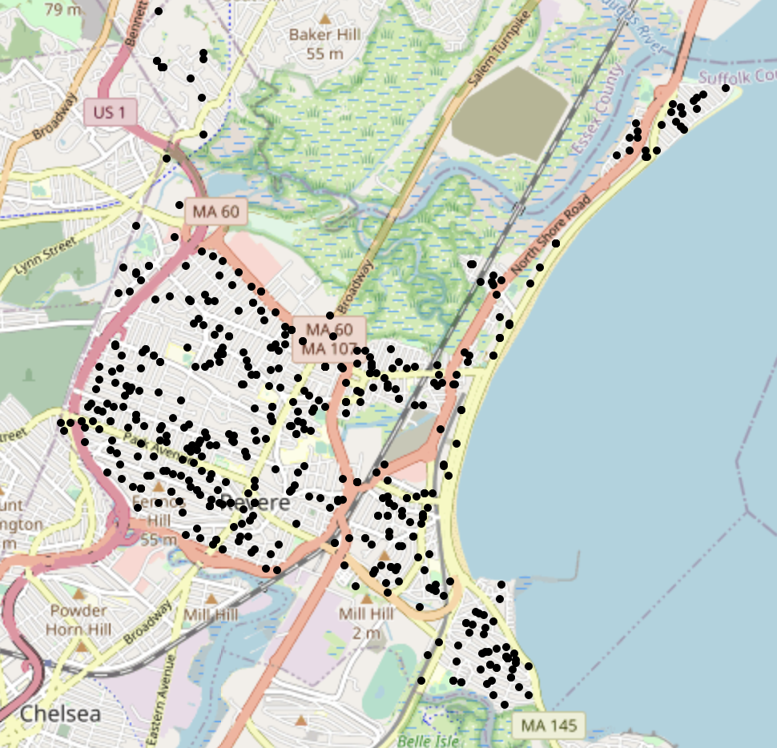
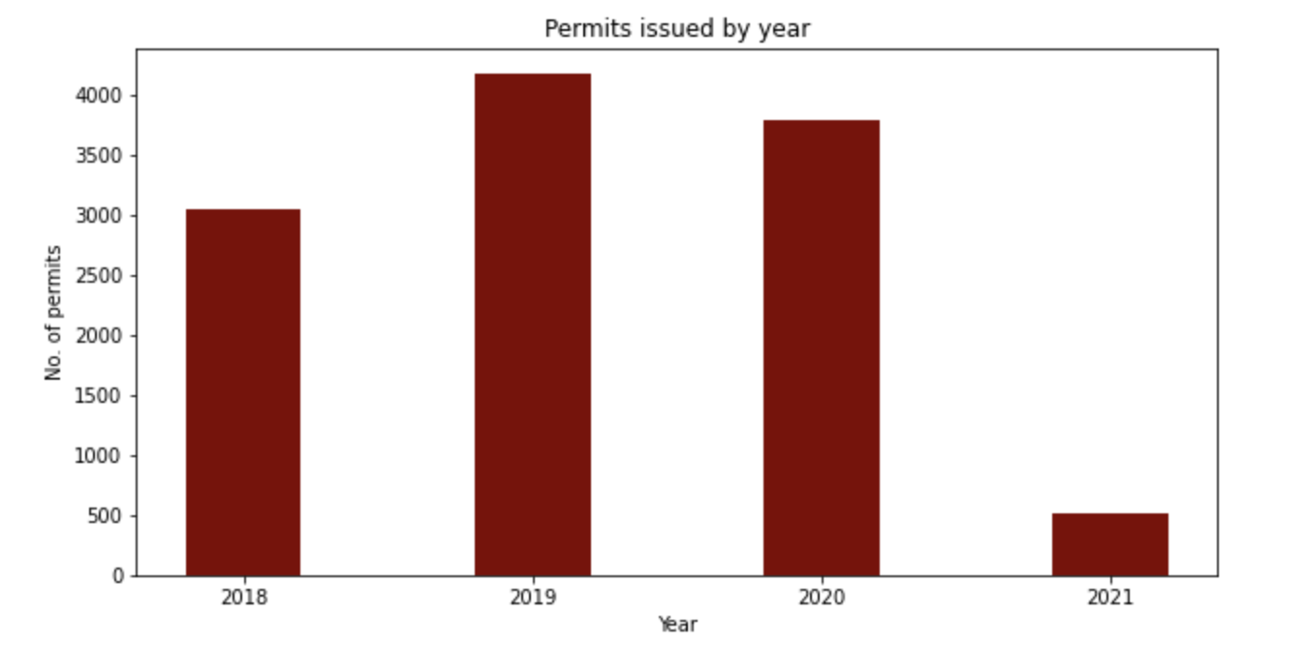
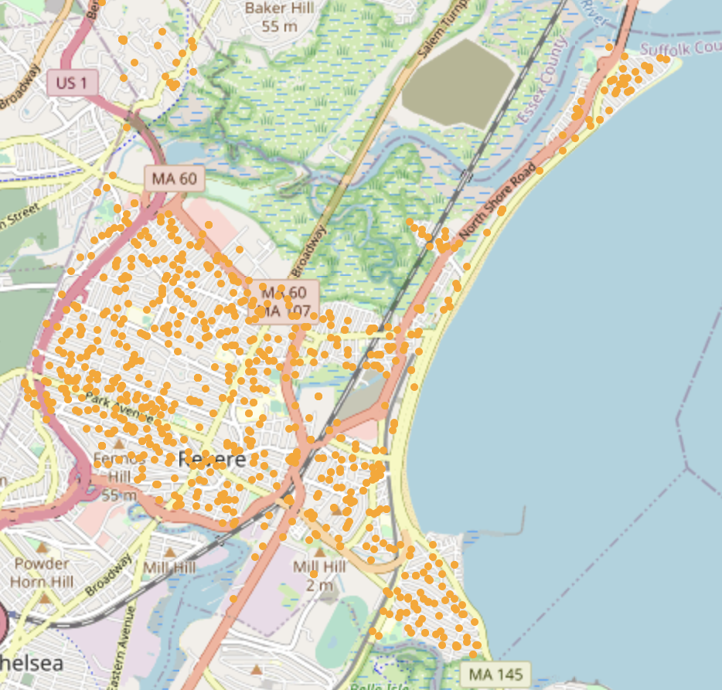
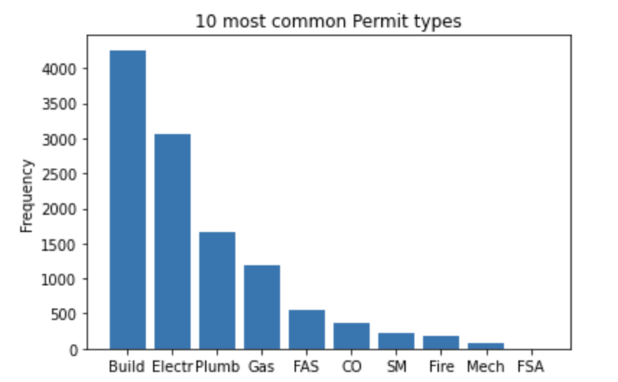
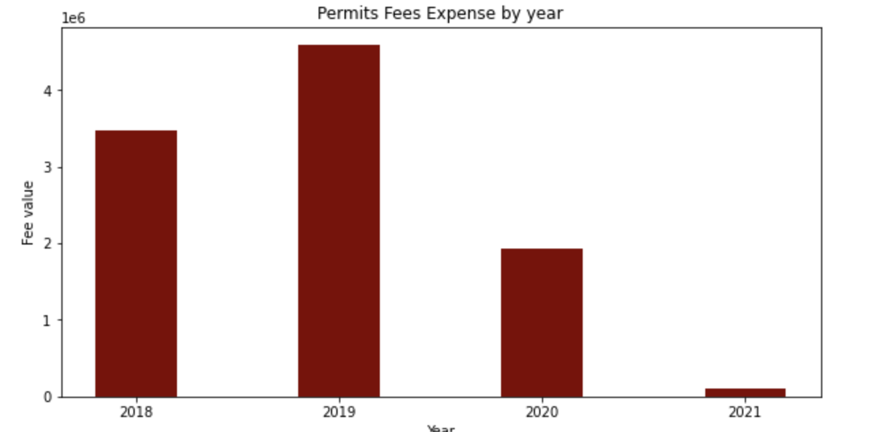
Permit Data
Electricity Permits Plumbing Permits
Building Permits
Notes:
John
From the analysis above dealing with permit expense, types, geographic distribution, we discovered that The City of Revere received most permits relating to Building, Electrical and Plumbing Types of permits in general. Geographically speaking, Tract 1708 is the area with the most building permit in 2020.
A suggestion that can be given to the city council based on the analysis are summarized as focusing more support or service on the building infrastructure support, especially in Tract 1708.

Slide 8
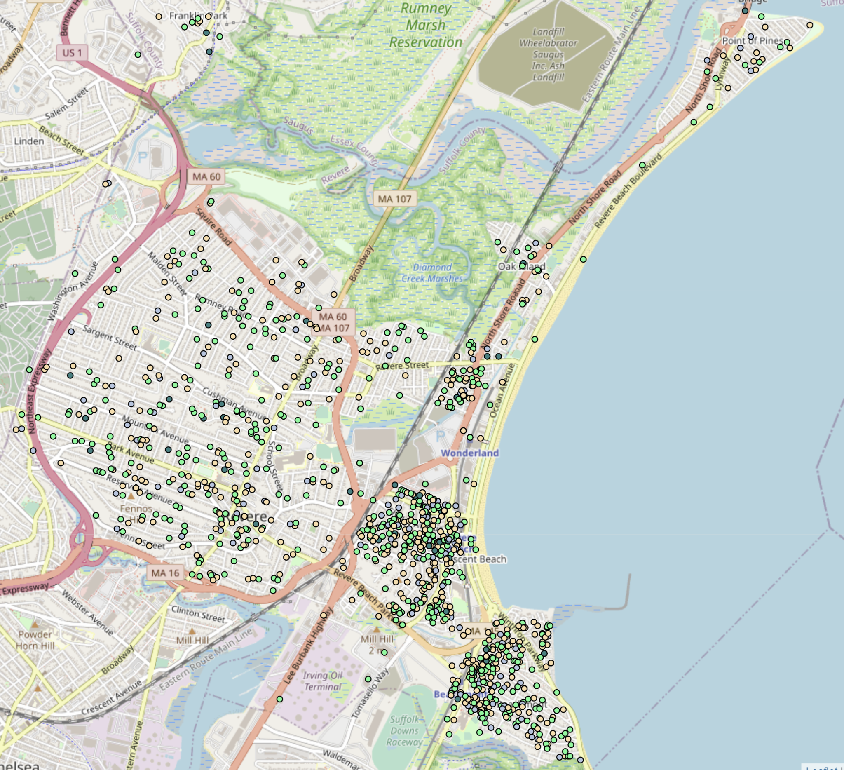
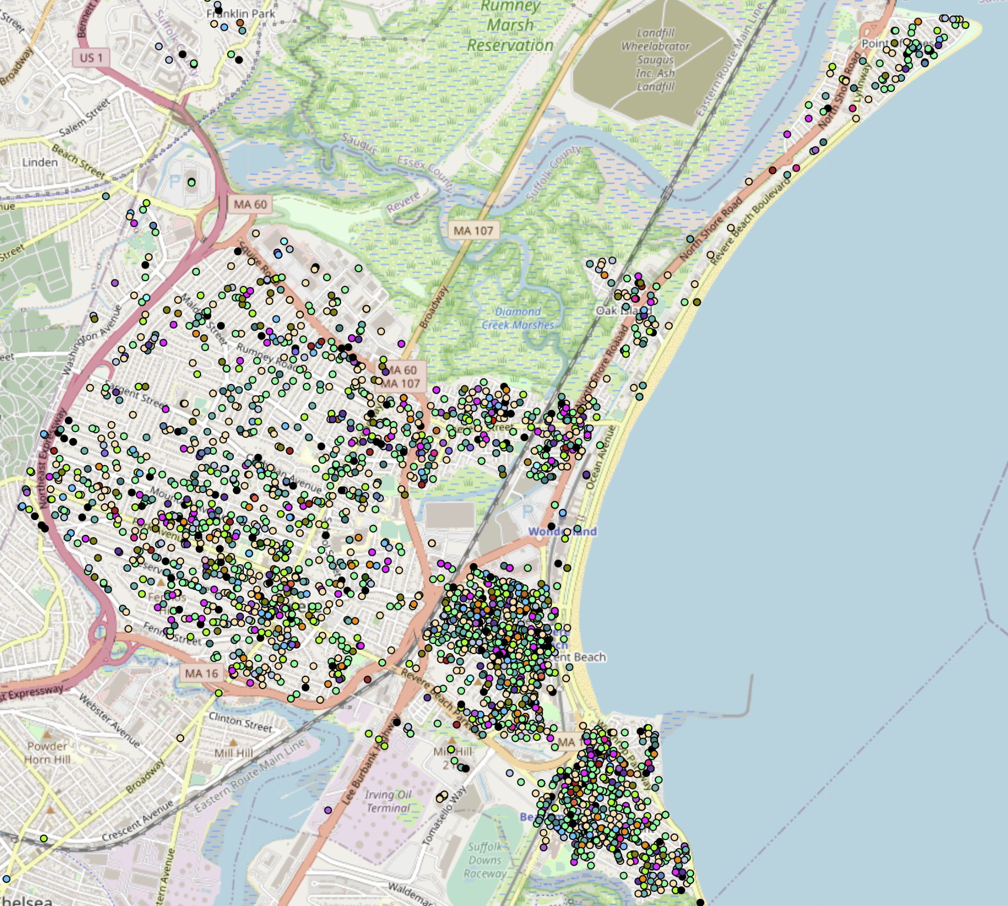
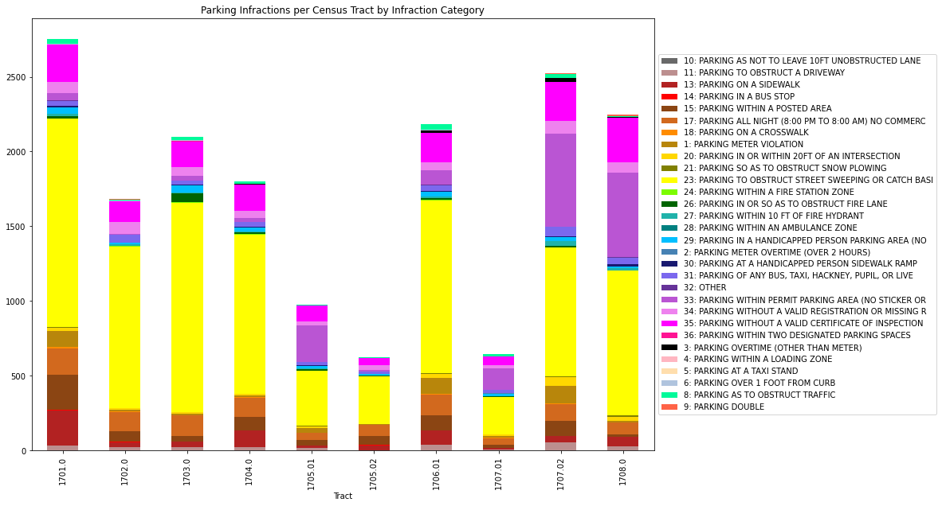
Parking Tickets
Parking overnight in non commercial parking (17), parking without permit (33), parking without a valid registration (34), or parking without a valid certificate inspection (35)
Parking fractions not coded parking meter (1, 2) or street sweeping (23)
Notes:
G
Another aspect to city services that we looked at were parking tickets. We began geocoding all the addresses of where parking violations occurred and mapping them to census tracts
One insight we found was that parking tickets tied to fixed events like street sweeping or parking meters tend to be clustered in neighborhoods bordering the beach or near the MBTA stations, we decided to remove these from the data set because there isn't much demographic information gained from these popular areas. And you can see this data mapped on the right.
We mapped the parking violations that we believe affect low-income households we believe this because private parking might not be available in these neighborhoods and permits, inspections, and registration might not be a priority for these households.
But Without data about the drivers, it is unclear what their exact demographic group and what drivers are residents or just passing by.

Slide 9
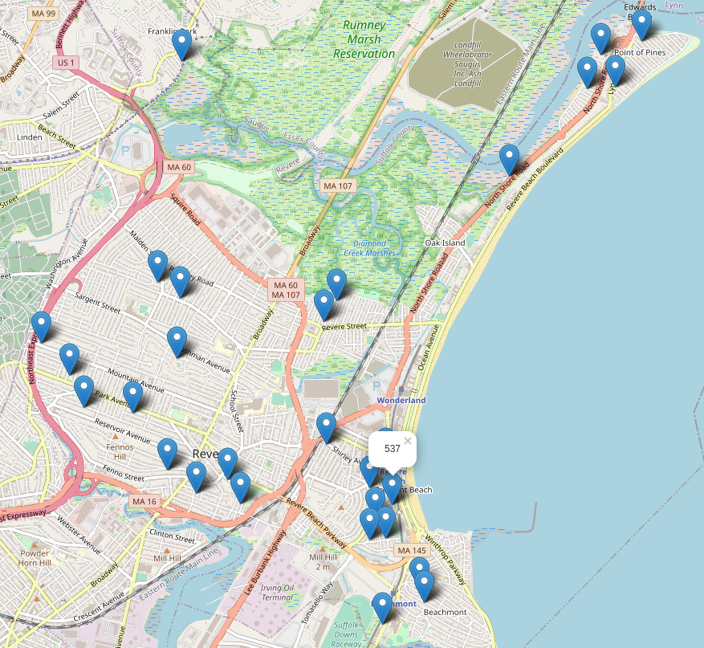
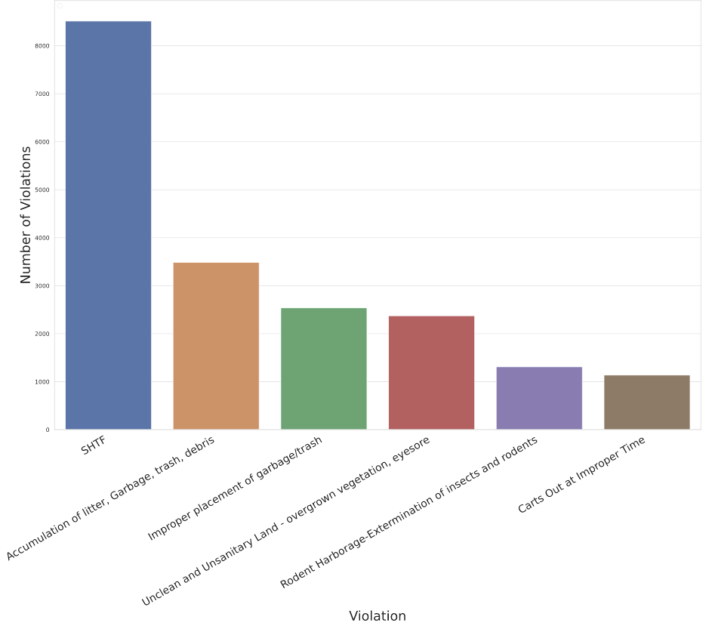
Housing Violations
Notes:
G
The last city service we looked at were housing violations. These were violations given to commercial and residential properties.
Given the time constraint we were not able to go as in depth with this data set as we would like but we were still able to create some visualizations regarding some of the most common violation types, and mapped the addresses with the most common violations.

Slide 10
Challenges
Understanding different types of Maps (Choropleth vs heat map)
Understanding the difference between different types of Census Data
How to geolocate using shape files to translate Lat/Long
Determining what sort of meaningful implications we can find with our data
Notes:
Kenzie
Understanding different types of Maps (Choropleth vs heat map)
Understanding the difference between different types of Census Data
How to geolocate using shape files to translate Lat/Long
Determining what sort of meaningful implications we can find with our data
Characteristic of whiteness was analyzed
Bit problematic
Better metrics for discrepancy
Hard to find with just ACS data and limited knowledge of quantitative methods

Slide 11
Limitations and Next Steps
Limited specificity geographically
Some data only goes to block group level
Differences in how neighborhoods are shaped vs administrative boundaries
Lack of understanding of the makeup of Revere due to COVID-19, preventing the team from going to get their bearings
Lack of support for analyses like “latent class analysis” through Python and classification of over vs under reporting neighborhoods in 311 complaints
Notes:
Kenzie
The largest problem with the project is the lack of segmented data on race and ethnicity through the American Community Survey. When the 2020 census data is publicly released, there will be a greater opportunity for specificity and actionable results from the currently curated data.
Thanks to professor Dr. Lorena Estrada-Martínez of UMass Boston, we were able to understand ways in which our analysis could be improved. Unfortunately, this conversation came too late in the project cycle to be actionable. In future projects, meetings with experts should come earlier in the project’s timeline and potentially occur more often to ensure that analysis is on the right track.
Without local knowledge coming from residents, students are limited in where to look for discrepancies. Obviously complicated by the pandemic, students should start off the semester with a trip to Revere to understand the neighborhood dynamics
We also had trouble trying to identify blocks as over- or under- reporting without having a ground truth to how many requests should be coming in. In another study, the researchers were able to use satellite data and determine street quality for each census block and then look at how many pothole fixing requests there were in that block. Because the researchers had a ground truth of the true condition of that area, they were able to calculate how many requests were expected and then categorize the data into under- and over-reporting.

Slide 12
Thank you!
Notes:
1min Background / Motivation / Goals
3min Results / analysis
30s Challenges along the way
30s Limitations / Next Steps

